Slide 1
Bio& 241 A&P 1
Unit 4 / Lab 1

Slide 2
Histology Slides for Nervous Tissues
Slides are presented in order of magnification if different view are presented.
As you view the following slides make sure you can accomplish these goals:
Can you identify the tissue observable on the slides?
Can you identify the specific structures or layers indicates by the numbered arrows or brackets?
At the end of a sequence you will find the answers to the above for each slide.

Slide 3
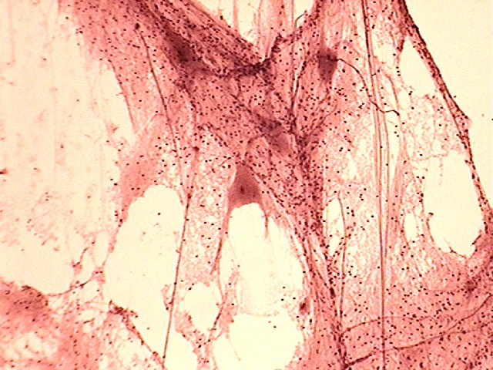
1
1
1
1
3
2
2
3
100X

Slide 4
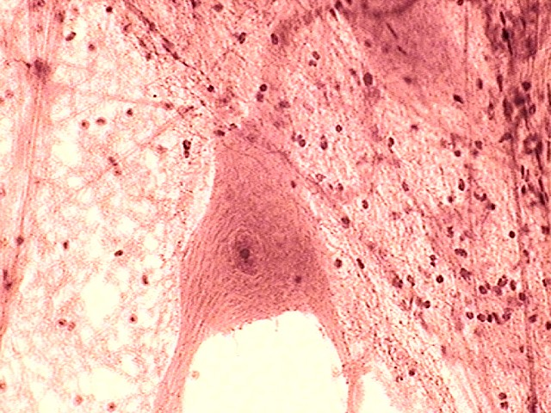
3
3
2
1
2
4
400X

Slide 5
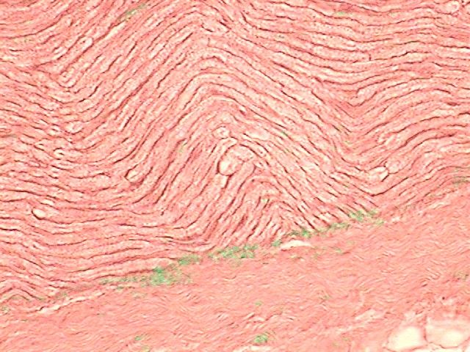
5
5
5
5
400X

Slide 6
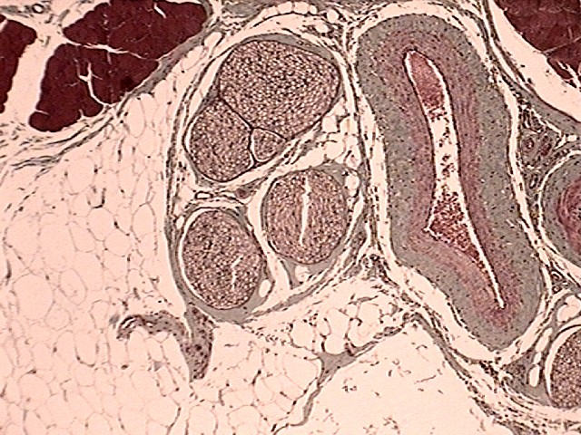
8
8
7
7
8
8
6
100X

Slide 7
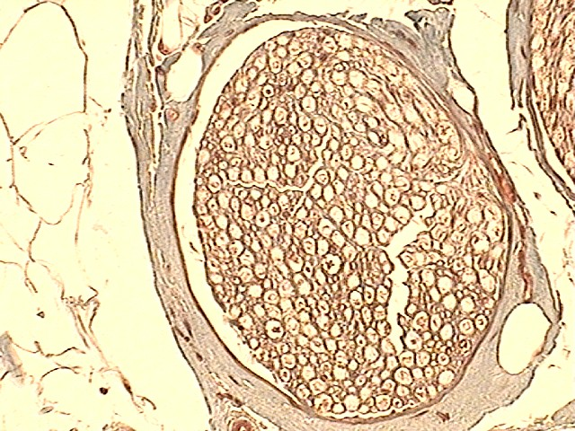
7
8
6
11
9
10
400X

Slide 8
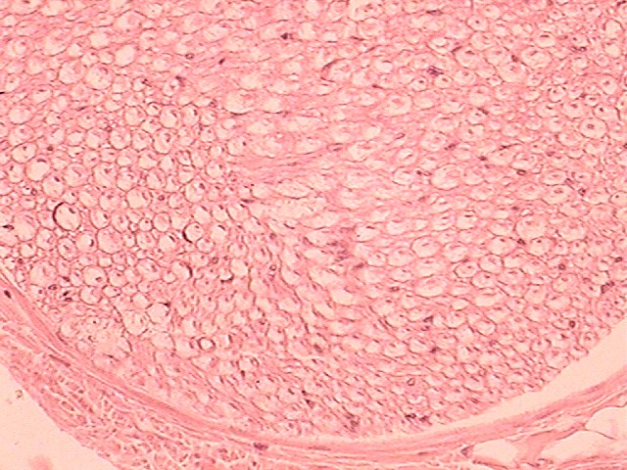
8
9
11
10
12
12
7
400X

Slide 9
Answers to Slides 2 through 7
Slide 2: Smear of gray matter low power.
Slide 3: Smear of gray matter high power.
Slide 4: Longitudinal view of myelinated nerve fibers.
Slide 5: X-section of a nerve low power (Masson stain)
Slide 6: X-section of a nerve high power (Masson stain)
Slide 7: X-section of a nerve high power (H&E stain)
Answers to the numbers:
Multipolar neuron cell body with nissl bodies, nucleus, and nucleolus.
Nerve fibers (axons of dendrites)
Neuroglial nuclei
Nucleus and nucleolus
Node of Ranvier
Epineurium

Slide 10
Answers to Slides 2 through 7
Answers to the numbers:
Perineurium
Nerve fasiscle
Endoneurium
Myelin sheath
Nerve fiber
Nucleus of Schwann cells

Slide 11
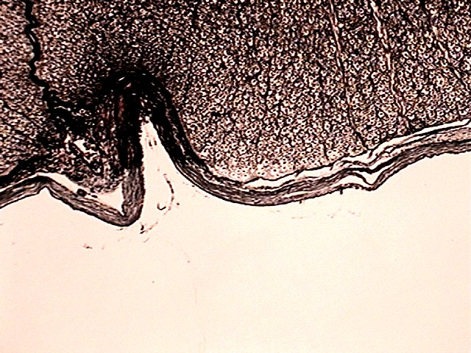
5
4
3
2
1
100X

Slide 12
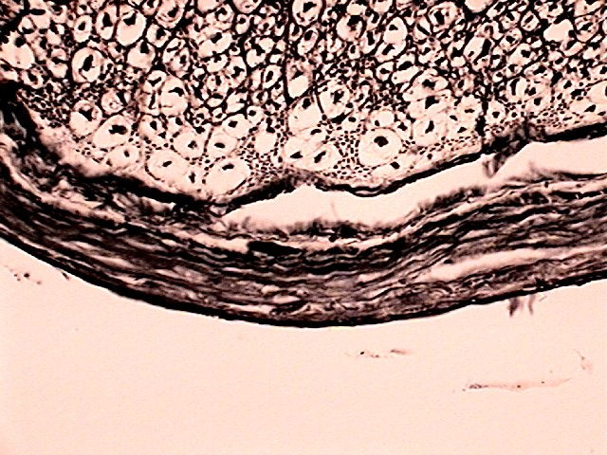
5
4
3
2
1
400X

Slide 13
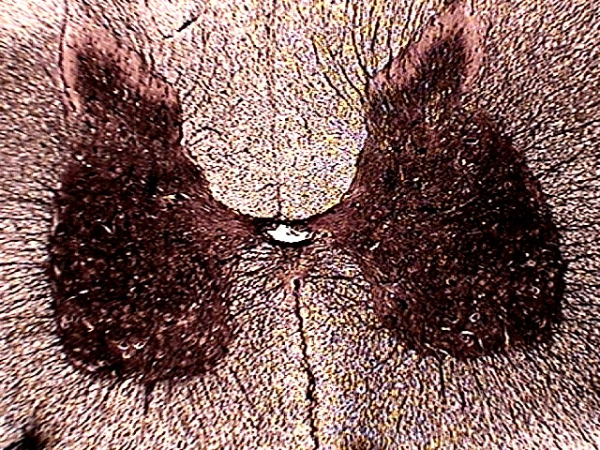
7
10
10
7
15
14
9
6
9
6
16
13
8
8
11
11
12
100X

Slide 14
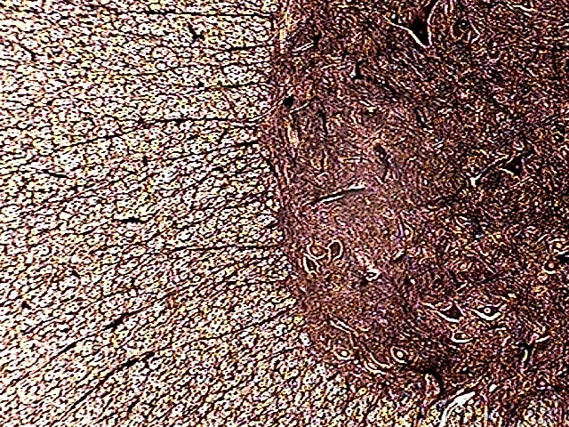
11
5
17
18
100X

Slide 15
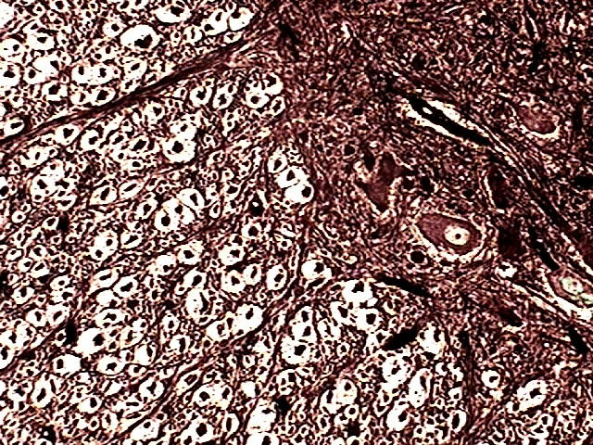
11
17
5
19
20
400X

Slide 16
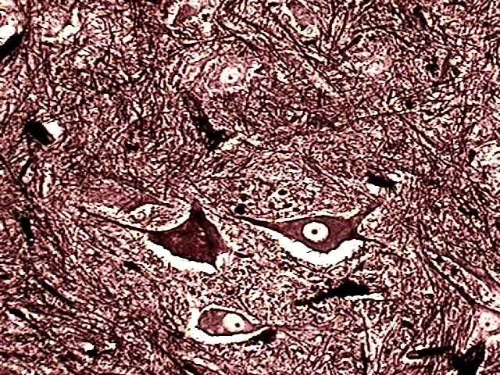
11
18
17
17
17
400X

Slide 17
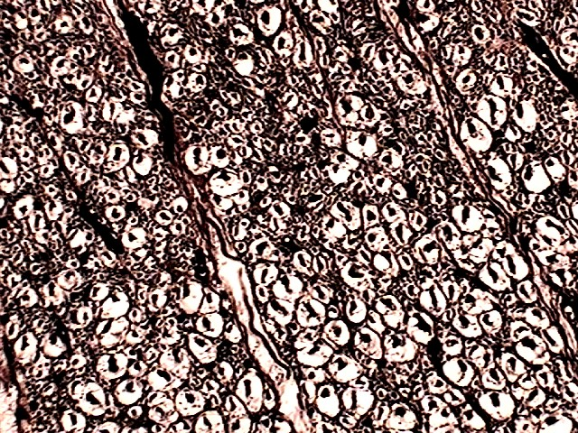
5
19
20
100X

Slide 18
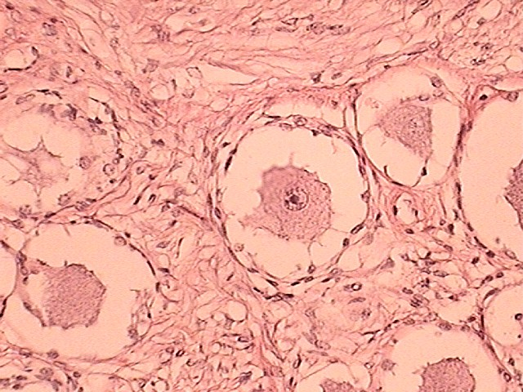
23
22
21
21
21
24
100X

Slide 19
Answers to Slides 10 through 17
Slide 10 - 16: X-section of spinal cord
Slide 17: Section through Dorsal Root Ganglion
Answers to the numbers:
Dura mater.
Arachnoid mater.
Subarachnoid space.
Pia mater.
X-section through white matter.
Gray matter
Posterior or dorsal white column
Anterior or ventral white column
Lateral white column
Doral gray horn
Ventral gray horn

Slide 20
Answers to Slides 10 through 17
Answers to the numbers:
Anterior or ventral median fissure
Central canal
Posterior gray commissure
Posterior or dorsal median sulcus
Anterior gray commissure
Multipolar neuron cell body
Transverse nerve fibers
X-section through a nerve fiber
Myelin sheath created by Oligodendrocytes
Sensory neuron cell bodies
Longitudinal view of myelinated nerve fibers
Nodes of Ranvier
Satellite cells

